Slide 1
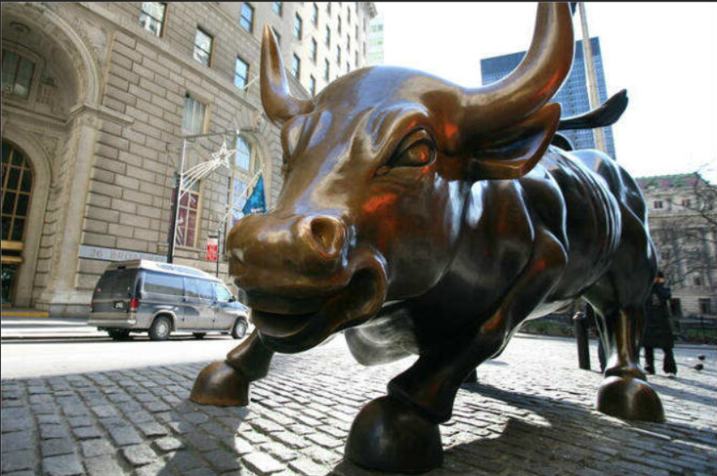
Stock Price Prediction
INTRODUCTION
What is Stock Market And How it Works
A stock market is a public market for the trading of company stock.
Stock market allows us to buy and sell units of stocks (ownership) of a company.
If the company’s profits go up, then we own some of the profits and if they go down, then we lose profits with them.
If more sellers than buyers, stock prices tend to fall. Conversely, when more buyers than sellers, stock prices tend to rise
Name :-Manish Devkota.
Roll No:- 2K18/EC/095.
Subject:-Machine Learning
Mentor :- Dr. Dinesh K. vishwakarma

Slide 2

Problem Statement
To Predict the future stock Price Of particular company using technical analysis.
Use different Machine Learning Model and Compare them in terms of their graphical analysis.
In this Project I will Use Time series concept.
Predict the future stock price using auto arima model and Lstm + rnn model

Slide 3
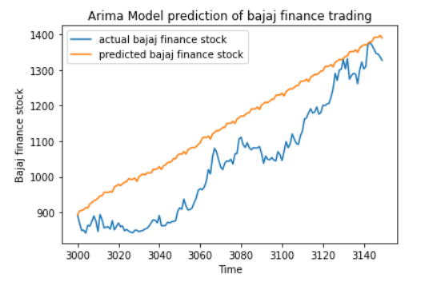
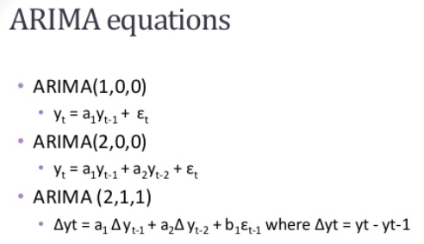
Arima Model
ARIMA, short for ‘Auto Regressive Integrated Moving Average’ is actually a class of models that ‘explains’ a given time series based on its own past values, that is, its own lags and the lagged forecast errors, so that equation can be used to forecast future values.
An ARIMA model is characterized by 3 terms: p(order of the AR term), q(order of the MA term), d(number of differencing required to make the time series stationary).
The purpose of differencing it to make the time series stationary.
Auto ARIMA, the model itself will generate the optimal p, d, and q values which would be suitable for the data set to provide better result.

Slide 4
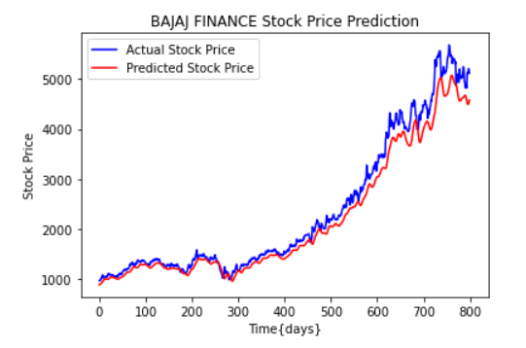
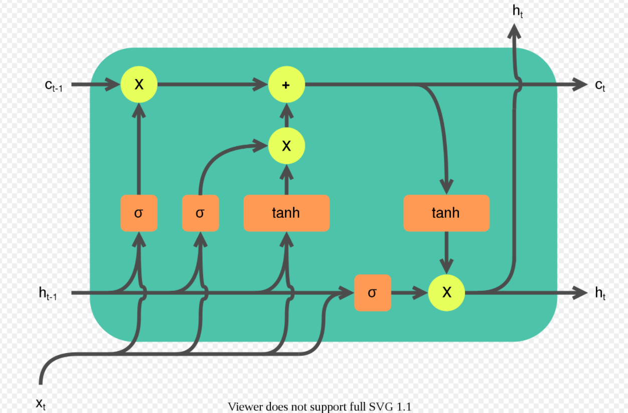
LSTM Model
Long short-term memory (LSTM) is an artificial recurrent neural network (RNN) used in the field of deep learning. Unlike standard feedforward neural networks. LSTM has feedback connections. It can not only process single data points (such as images), but also entire sequences of data (such as speech or video).
A common LSTM unit is composed of a cell, an input gate, an output gate and a forget gate. The cell remembers values over arbitrary time intervals and the three gates regulate the flow of information into and out of the cell.
The advantage of an LSTM cell compared to a common recurrent unit is its cell memory unit. The cell vector has the ability to encapsulate the notion of forgetting part of its previously stored memory, as well as to add part of the new information.

Slide 5
Conclusion
By comparing the two forecasting plots, we can see that the ARIMA model has predicted the closing prices very lower to the actual prices. This large variation in prediction can be seen at the majority of the places across the plot. But in the case of the LSTM model, the same prediction of closing prices can be seen higher than the actual value. But this variation can be observed at few places in the plot and majority of the time, the predicted value seems to be nearby the actual value. So we can conclude that, in the task of stock prediction, the LSTM model has outperformed the ARIMA model.
We can also conclude this by comparing Root Mean Squared Error.
RMSE with Arima 127.640563493
RMSE with LSTM 90.923716650748005
LSTM Model Output
ARIMA Model Output

